Slide 1
DATABASE INFORMATION RETRIEVAL USING FACIAL IDENTIFICATION
G.Deep Aman(50524338)

Slide 2
AIM OF THE PROJECT
The main aim of the project is to ease the process of recognizing a person and retrieving their info from the database. This project will take into consideration all the requirements that one need for this application, once their data is stored at the back end, whenever he/she again want to enter certain premises or office he will be recognized using his facial data, and his data is retrieved and verified.

Slide 3
DATASET
First Dataset: This dataset has about 150 photos in each folder, arranged into 12 folders. Every folder corresponds to a unique category or person, and we create a different VGG16 model for every category. By taking such care, we are able to customize the models to unique characteristics and complexities within each category, which improves the model's capacity to identify and distinguish between distinct celebrities.
The second dataset: The second dataset, on the other hand, is larger and consists of 13 folders containing around 3400 photos. I apply both the VGG16 and VGG19 algorithms for this dataset. By employing these two methods, we can capture a greater variety of specifics and details seen in the images. Our models are well-trained on this diverse dataset, which ensures that they are capable of handling the levels of detail and volatility that come with processing a bigger dataset.

Slide 4
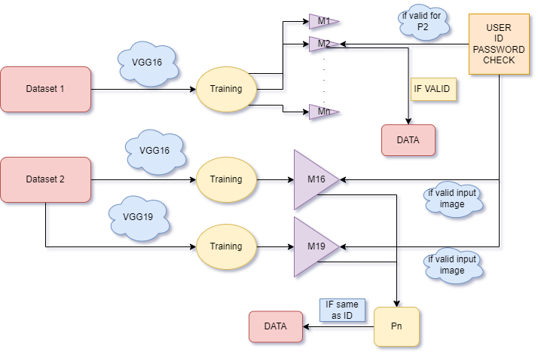
APPROACH

Slide 5
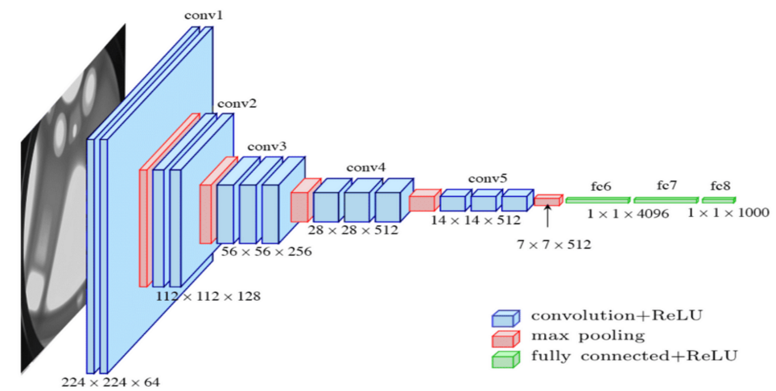
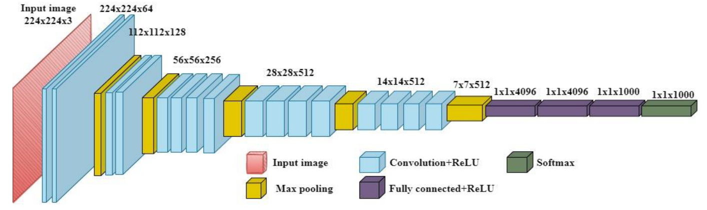
ALGOS
VGG16
VGG19

Slide 6
Image Operations
I've manually created a set of image processing tasks for my project to improve the pre-training set for facial recognition models. Using the Python Imaging Library (PIL), the load_and_resize_image function reduces the size of the given facial image to a feasible 128x128. The model's vulnerability can be improved by scaling the pixel values to a range of 0 to 255 using the normalize_image function. The clip_image_values function makes sure the pixel intensities stay within a suitable range in order to control extreme values. Using convert_to_gray to convert the picture to grayscale makes further processing easier. Lastly, a Gaussian blur is employed by the denoise_image function to reduce noise in the grayscale image.
I've manually created a collection of techniques that can customize the training dataset to provide a robust image augmentation for my project. While flip_image_horizontal provides horizontal mirroring for an additional point of view, rotate_image adds variation by rotating images. Using the adjust_brightness function to change brightness ensures that it may be adjusted to suit different lighting conditions. The random_scale function adds scale variations, whereas the random_crop function randomly chooses locations for spatial diversity. The add_noise method adds controlled noise to the scene to give it an increased sense of reality. By exposing the model to a wide range of training options, these manual data augmentations greatly increase the model's robustness.

Slide 7
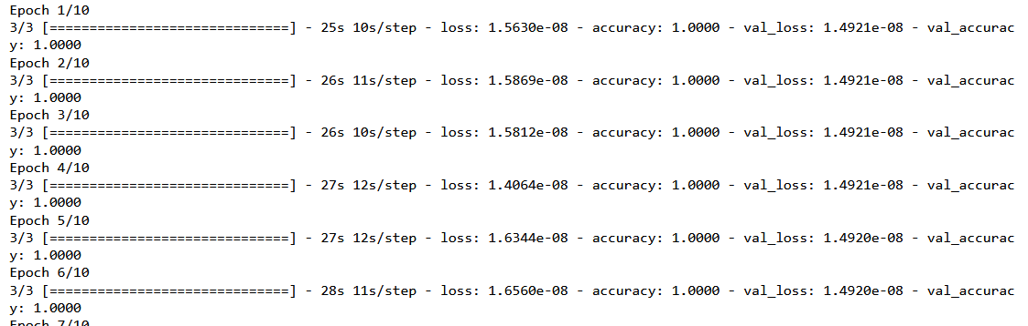
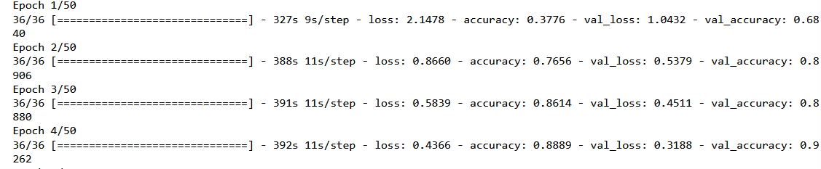
Training Process
For the model that is trained individually we ran 10 epochs for each model.
Whereas for the models that are trained on the entire dataset we have used 50 epochs to ensure robustness.

Slide 8
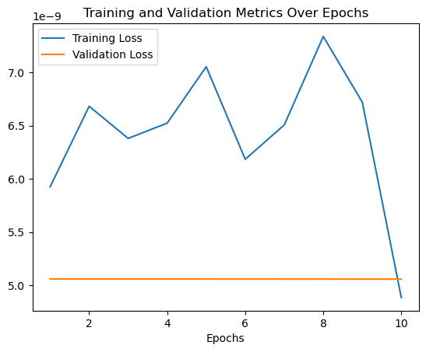
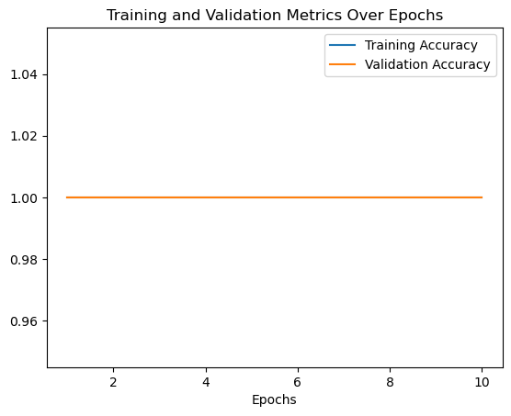
Results for individual

Slide 9
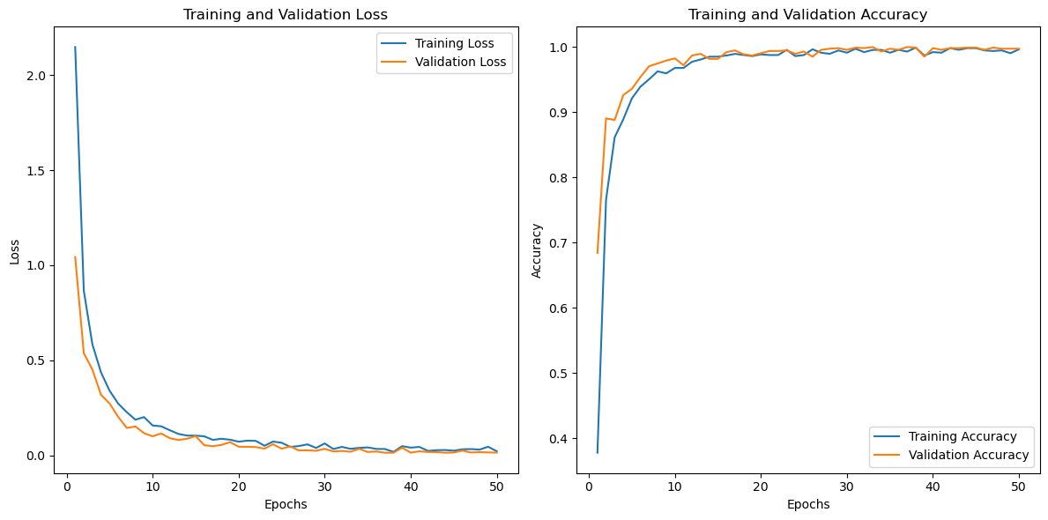
Result total Data Model for VGG16

Slide 10
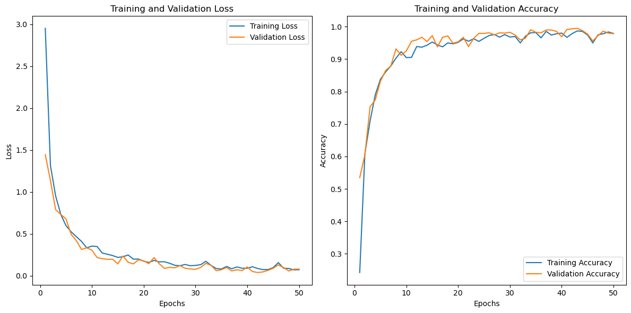
Result total Data Model for VGG19

Slide 11
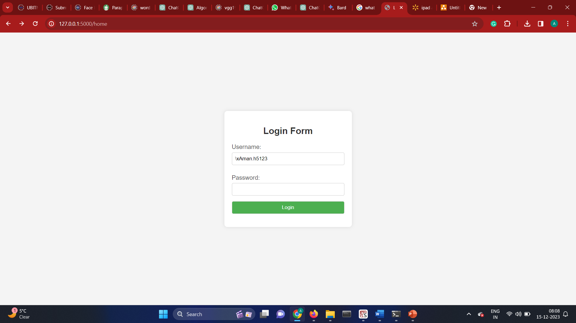

INTERPHASE

